Slide 1
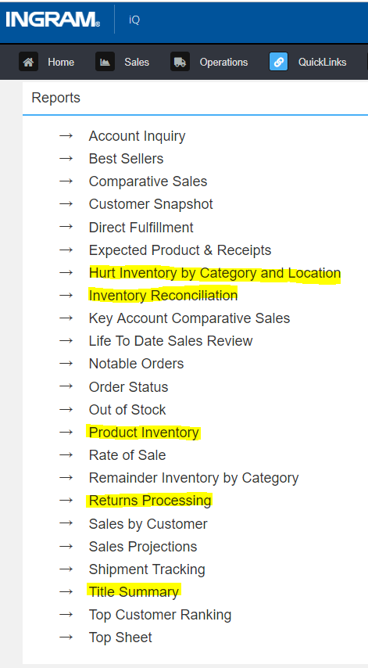
Highlighted are QuickLinks Reports in iQ that will either become visible or be added as a part of the returns changes being implemented in the Jackson warehouse systems.
Please note: Wherever Available with Notice is added as a column or field option it will be seen by all users, even if they have no product in Jackson.

Slide 2
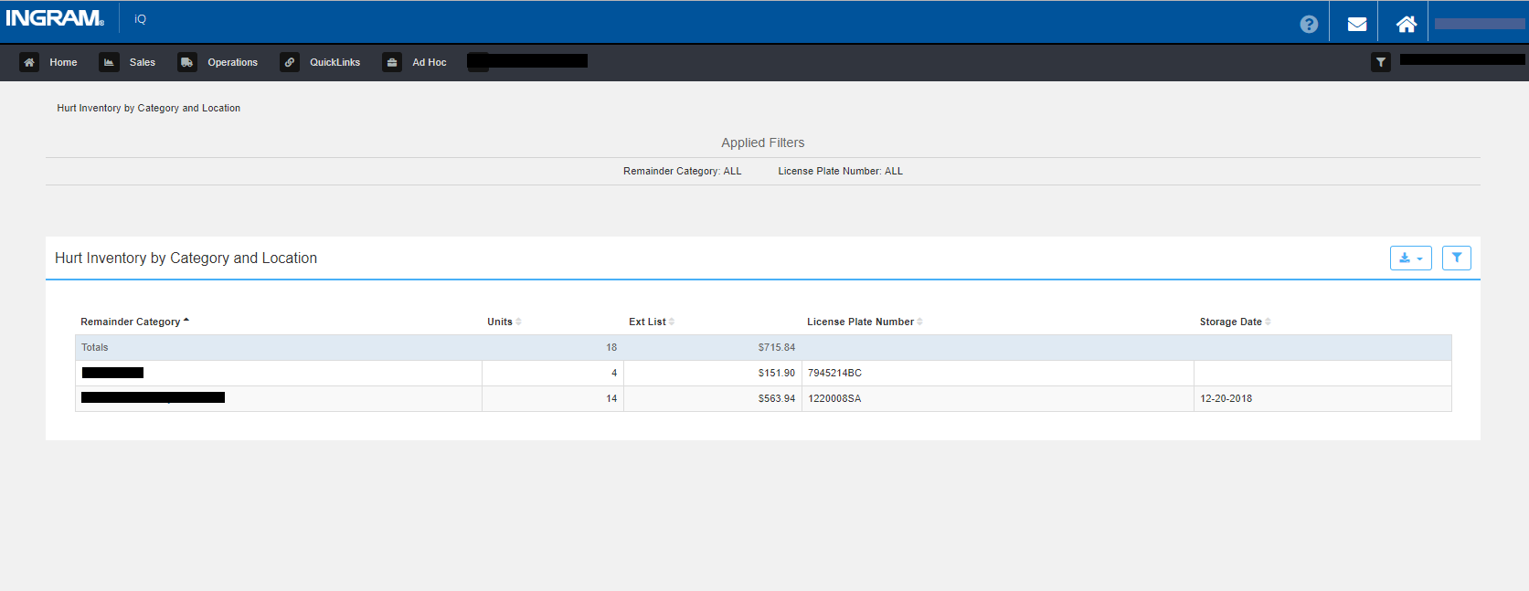
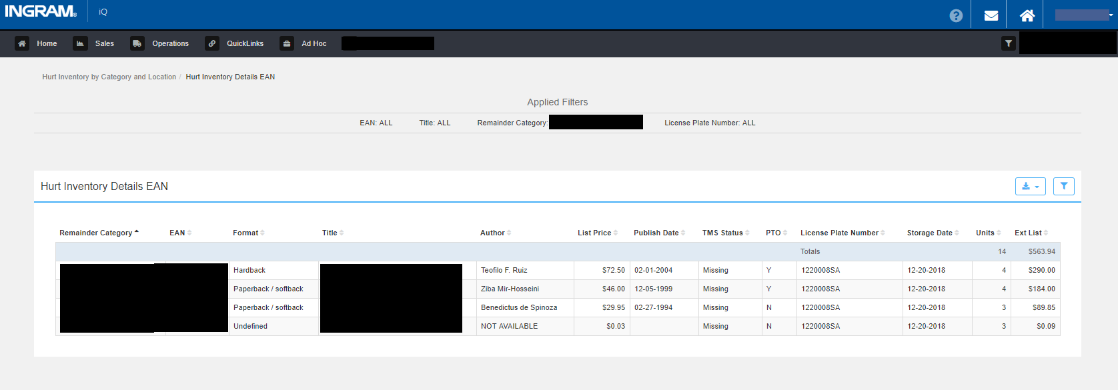
New QuickLinks Report - Hurt Inventory by Category and Location with drill through to Hurt Inventory Detail EAN
These reports give visibility to hurt inventory by their remainder category and license plate currently within the warehouse.
It is at a summary level report by category and license plate that can be drilled through to EAN level detail.

Slide 3
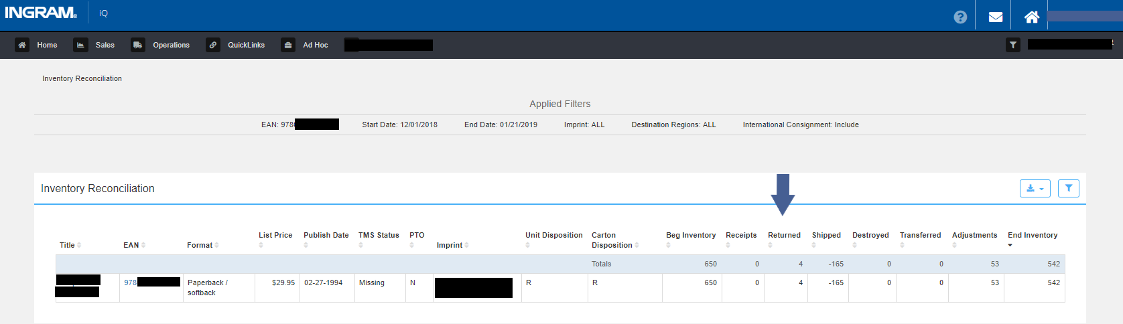
Inventory Reconciliation Report (QuickLinks Report or Drill through from Operations Dashboard/Ending Inventory Snapshot)
Returned Units will begin to be reflected in reporting for Jackson
The conversion of hurt product will be seen as a negative single unit per shroud transfer out of the generic hurt sku and positive units transferred into the individual EANs.

Slide 4
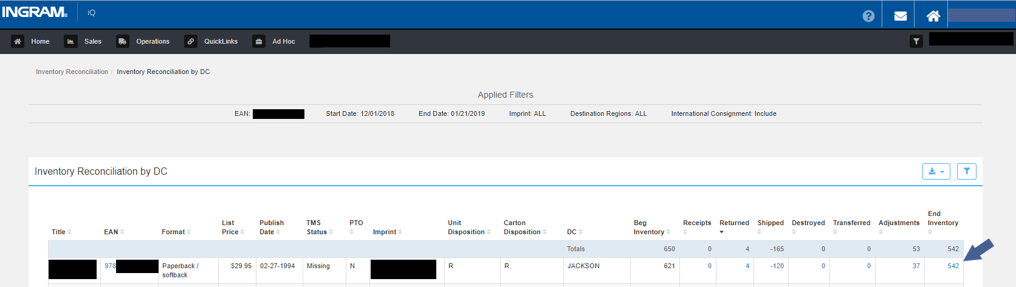
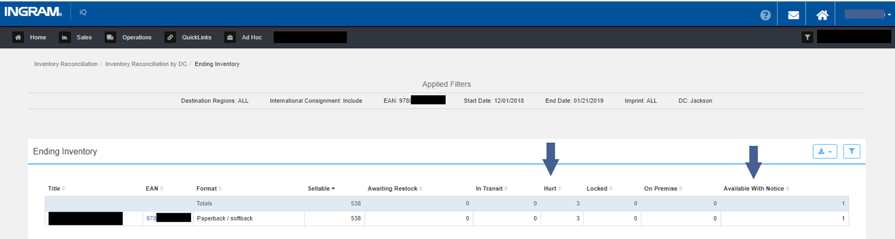
Ending Inventory (Path - Inventory Reconciliation / Inventory Reconciliation by DC / Ending Inventory)
A new Inventory Position of Available with Notice will show and Hurt units will begin to be reflected at the EAN level

Slide 5
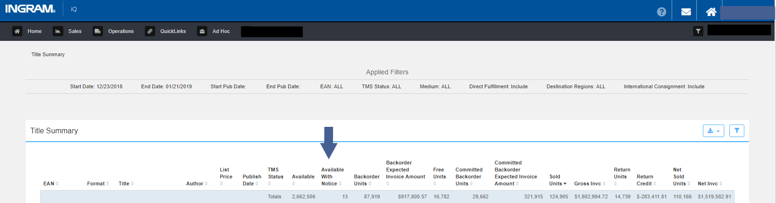
Available with Notice will be added to the Title Summary Report.
Please note: The Available with Notice column will be seen by all users, even if they have no product in Jackson.

Slide 6
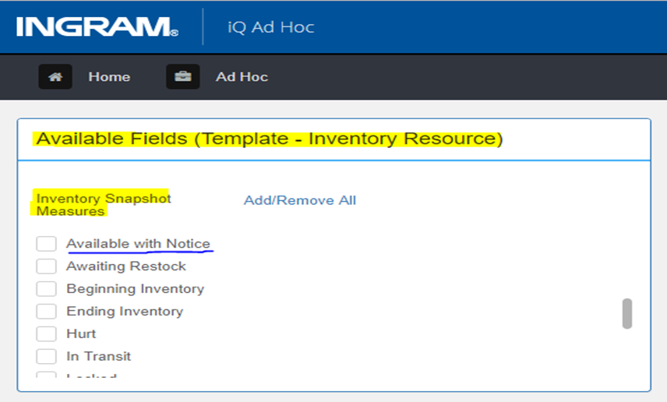
Inventory Resource (Ad Hoc Template)
Please note: The Available with Notice field option will be seen by all users, even if they have no product in Jackson.
Returned Units will begin to be reflected in reporting for Jackson
A new Inventory Position of Available with Notice will be a field option and Hurt units will begin to be reflected at the EAN level
The conversion of Hurt product will be seen as a negative single unit per shroud transfer out of the generic hurt sku and positive units transferred into the individual EANs

Slide 7
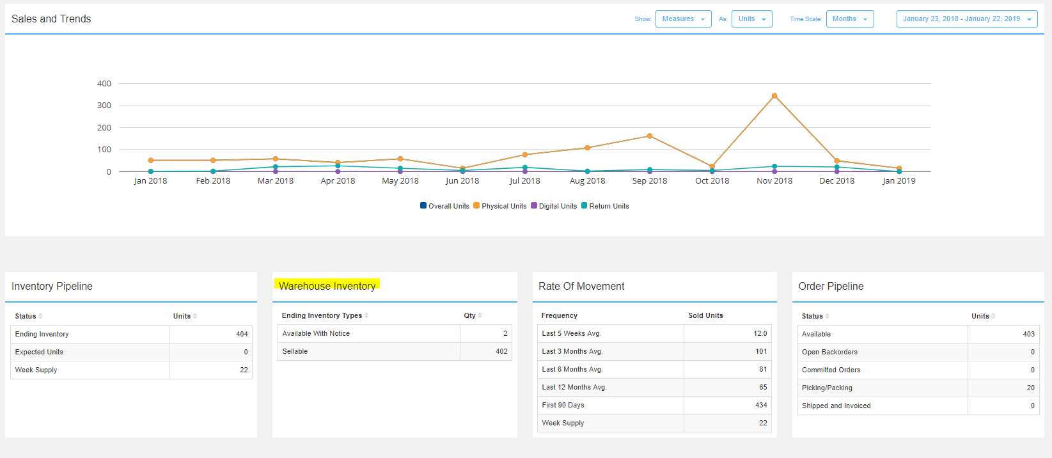
EAN Dashboard
Available with Notice will be included in the Warehouse Inventory widget if there are units in that category.

Slide 8
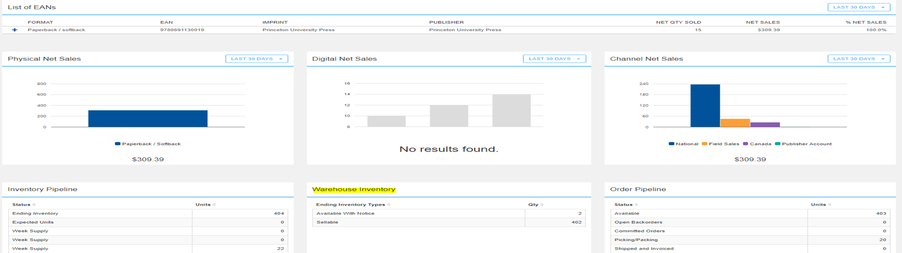
Related Formats Dashboard
Available with Notice will be included in the Warehouse Inventory widget if there are units in that category.

Slide 9
Other Reports not pictured
New QuickLinks Report - Returns Processing
This report contains Title and DC level information regarding the units that are processed in various ways during returns. Rework, Restock, SVA Sort (Hurt), Destroy and Bin and Hold.
Product Inventory (QuickLinks Report)
Add Damaged and Received Not Stocked column to complete OMS inventory perspective
Also adding Available with Notice from warehouse inventory perspective
Titles in Jeopardy
Adding Available with Notice to existing report

